Slide 1
PFAS: Current Trends in Class Action and Mass Tort Litigation May 8, 2023
2023 Class Action Money & Ethics Conference

Slide 2
AGENDA
Introduction of presenters
Overview of PFAS chemistry, uses, and health concerns
PFAS consumer class actions and Prop 65 litigation
Regulatory developments’ effect on PFAS class actions
Overall trends in PFAS litigation
Q&A

Slide 3
Presenters
Thomas R. Waskom, Co-Head of the Product Liability and Mass Tort Group, Hunton Andrews Kurth LLP
Brian M. Ledger, Partner and Co-Chair of the Environmental Practice Group, Gordon Rees Scully Mansukhani, LLP
Paul T. Nyffeler, PhD, Senior Attorney, Hunton Andrews Kurth LLP
Jack Bisceglia, Associate, Hunton Andrews Kurth LLP

Slide 4
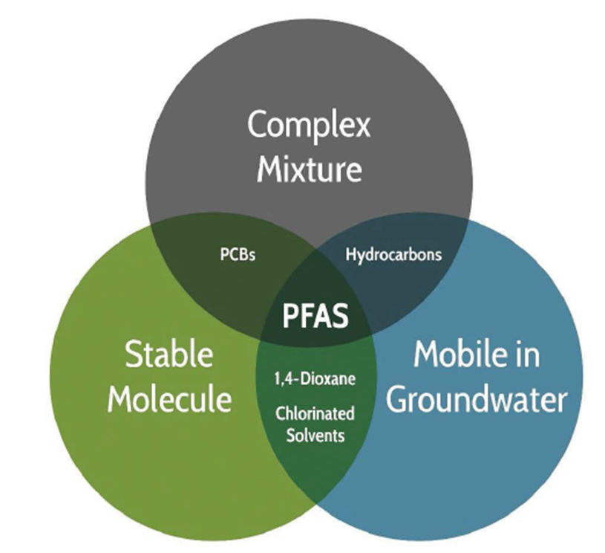
What are PFAS?
Per- and Polyfluoroalkyl Substances
Strong, stable C-F bonds
Hydrophobic and lipophobic
Relatively low volatility and high solubility
Mobile in the environment
Resistant to degradation
No natural environmental source

Slide 5
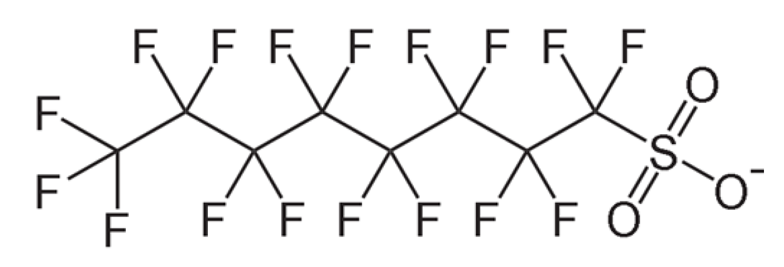
PFOA and PFOS
Most researched and prevalent PFAS in the environment
PFOA
-
Perfluorooctanoic acid
PFOS
Perfluorooctanesulfonic acid

Slide 6
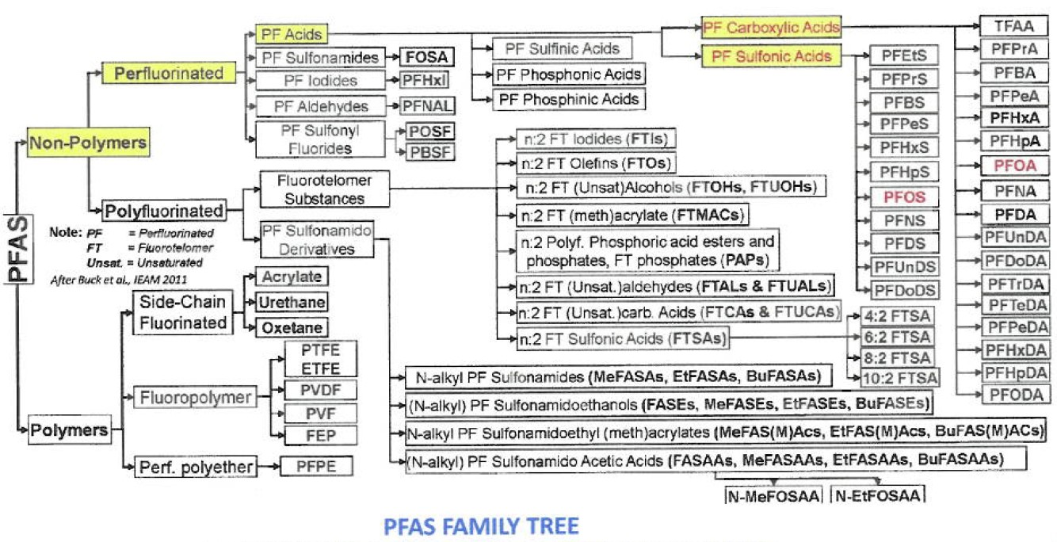
Chemistry
PFOS and PFOA are only the tip of the PFAS iceberg

Slide 7
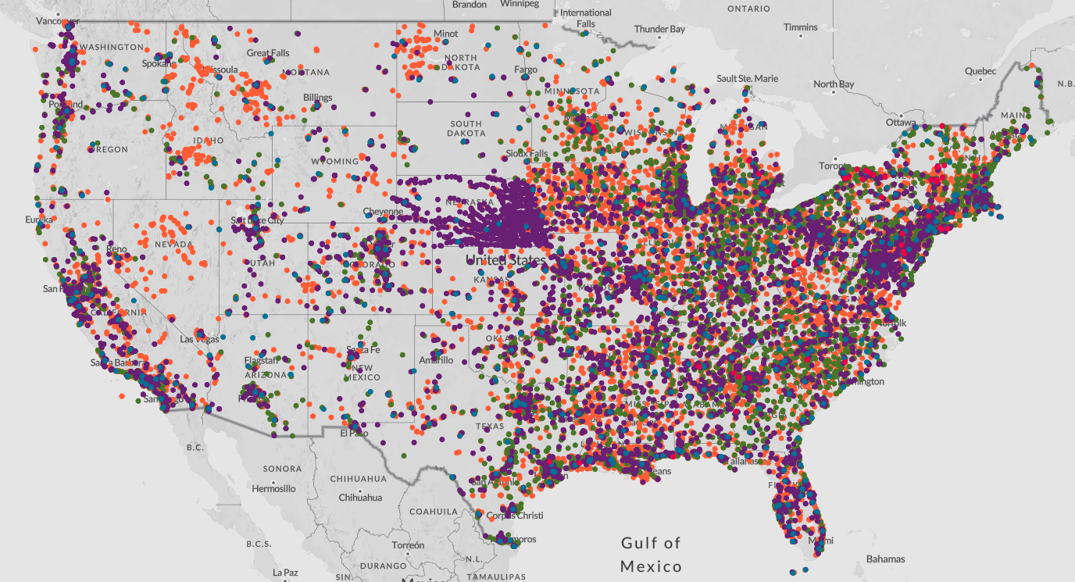
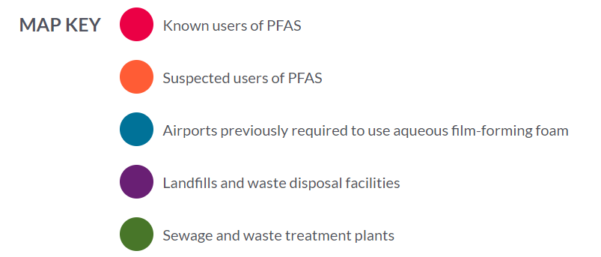
Locations
Water System Providers
Wastewater System Discharges and Sludge Management
Brownfield Redevelopment
Superfund Sites
Industrial/Product Compliance
Human and Ecological Exposure
Significant state-to-state variation in investigation and cleanup requirements
https://www.ewg.org/interactive-maps/2021_suspected_industrial_discharges_of_pfas/map/

Slide 8
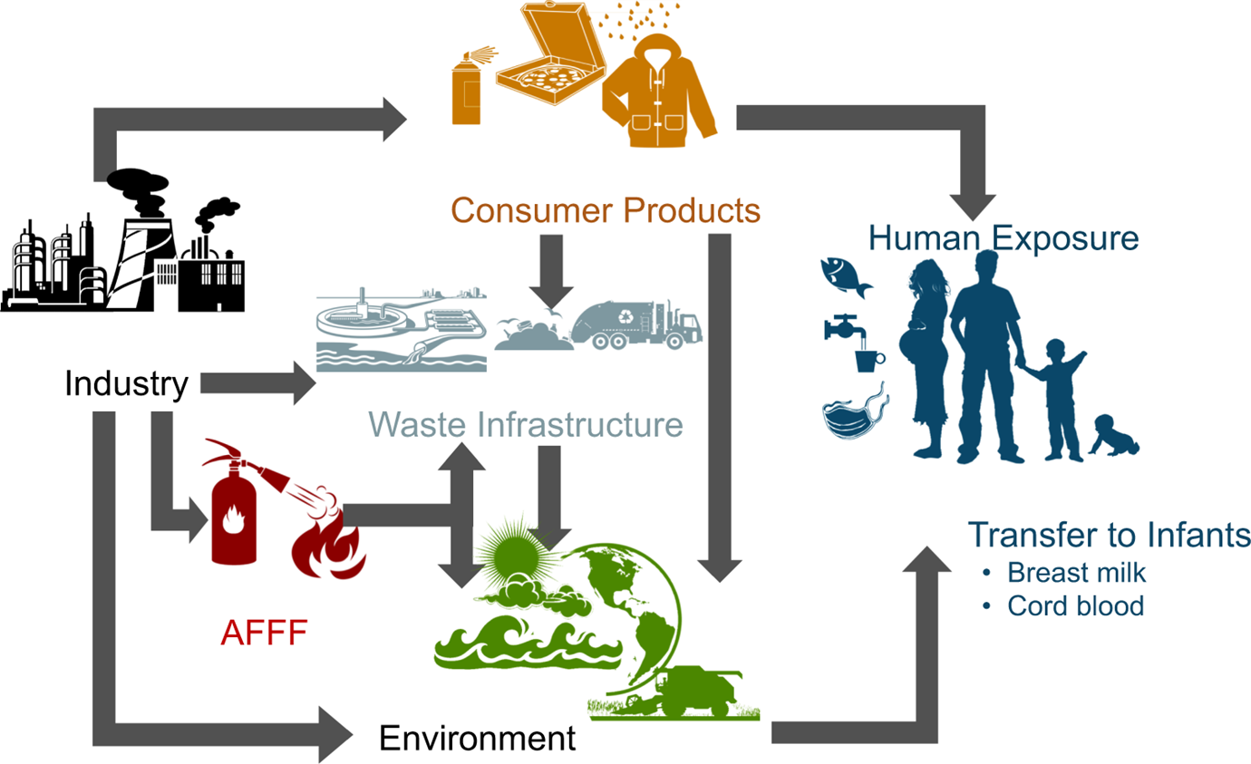
Exposure Pathways

Slide 9
Human Health
Regulated at parts per trillion levels
C8 Study “Probable links” between PFOA Exposure and:
High Cholesterol
Thyroid disease
Testicular and kidney cancers
Pregnancy induced hypertension
Evidence of PFAS carcinogenicity from C8 Panel studies and animal studies is inconsistent and/or inconclusive
Issue is somewhat moot as non-cancer health effects are driving the Lifetime Health Advisory, and this level is protective of potential cancer risk

Slide 10
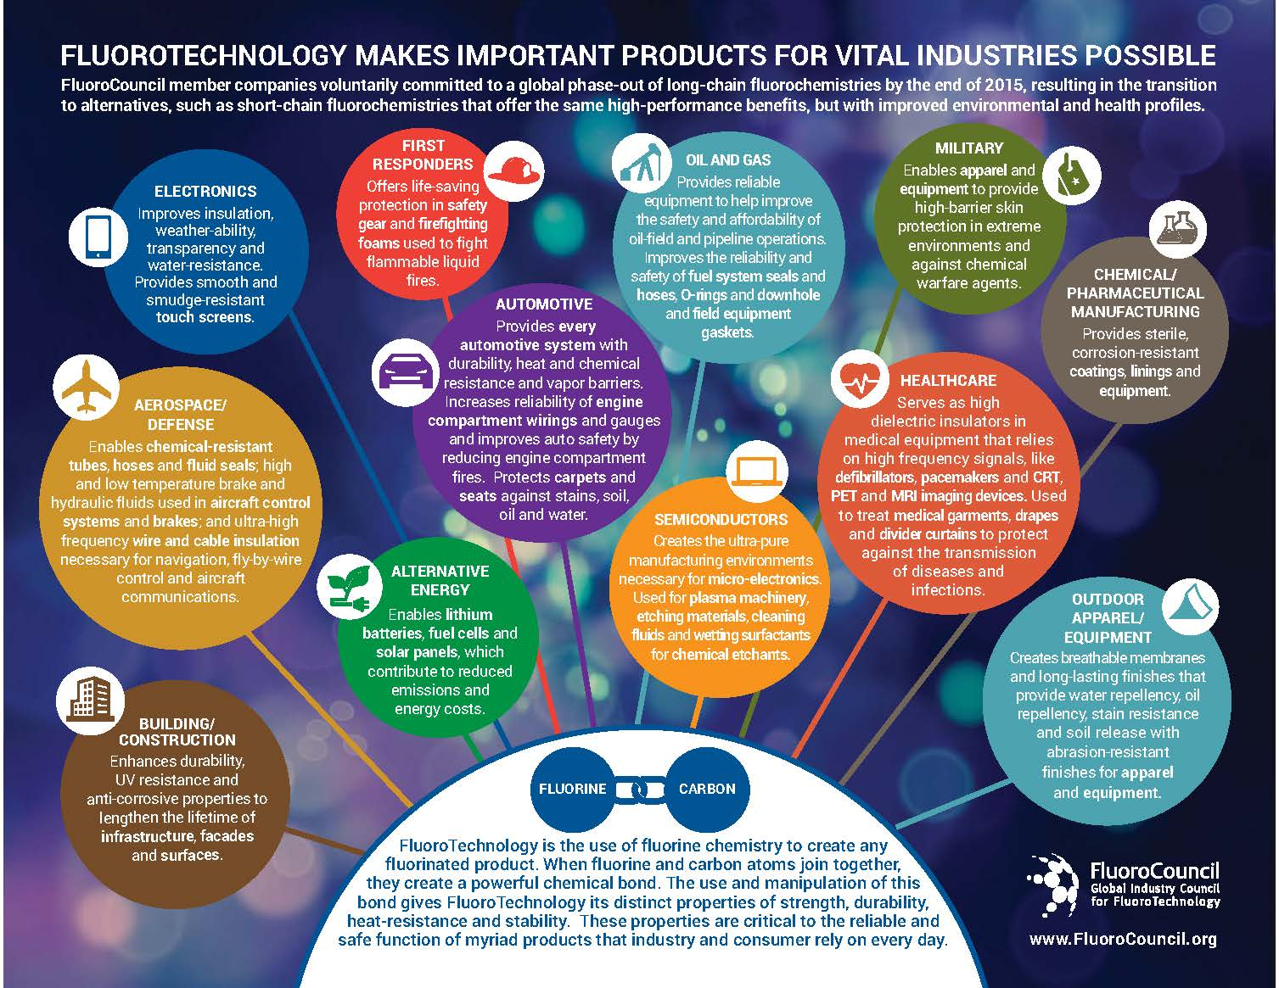
Products
Industries across the spectrum have incorporated PFAS into products or manufacturing processes
Industrial compliance and product liability issues are pervasive

Slide 11
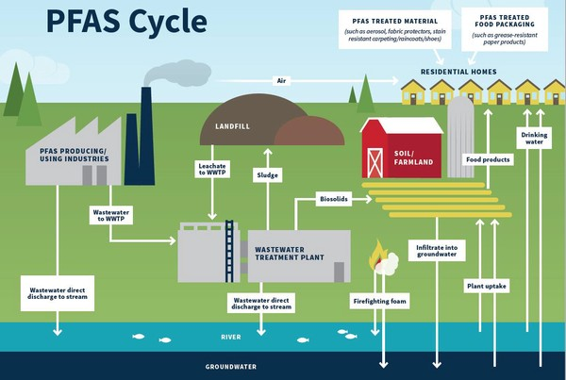
Environment

Slide 12
Proposition 65
and
PFAS Consumer Class Actions

Slide 13
Proposition 65 Overview
Approved by voters
Primary objective to inform public about exposure to chemicals deemed to cause cancer or reproductive toxicity
Prohibits discharging listed chemicals into drinking water sources
Prior to exposing individuals, clear & reasonable warnings must be given

Slide 14
Proposition 65 Overview To Whom Does It Apply?
Businesses with 10 or more employees
That expose individuals to listed chemicals at miniscule levels
Exposures can occur from:
Use of consumer products
Environmental discharges
Occupational exposures

Slide 15
Proposition 65 Overview Who Enforces The Law?
Public Prosecutors: California Attorney General/County District Attorney
Any person, after issuing a 60-day notice, when no public prosecutor has commenced and is diligently pursuing an action

Slide 16
Proposition 65 Overview What Penalties Can Be Assessed?
Civil penalties of up to $2,500 per exposure per day
Injunctions

Slide 17
Proposition 65 and PFAS
2017: PFOA and PFOS were identified by the State as reproductive toxins and added to the Prop 65 List.
2021: PFOS identified by the State as carcinogen.
2021: Perfluorononanoic acid (PFNA) and its salts identified by the State as reproductive toxin and added to the Prop 65 List.
2022: PFOA identified by the State as carcinogen.
2023: The State is also considering listing other PFAS: PFHxS and PFDA.

Slide 18
Proposition 65 and PFAS
Products targeted thus far:
Outerwear clothing and rain jackets
Baby bibs/crib mattress pads
Bath pillows
Duffel bags
Umbrellas
Shower liners
Tablecloths
Paper straws

Slide 19
Proposition 65 and PFAS
Top Tips for Companies to Help Protect Against Proposition 65 Liability
1. Establish a Compliance Policy
2. Identification of Suspect Products
3. Communication with Supply Chain Partners
4. Indemnity/Hold Harmless Agreements
5. Product Testing
6. Proper Warnings

Slide 20
Class Actions Focused on Consumer Products and PFAS
Common Claims
California Legal Remedies Act
Unfair Competition Laws
Breach of Express Warranty
Unjust Enrichment

Slide 21
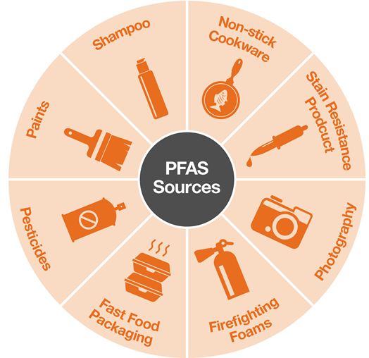
Class Actions Focused on Consumer Products and PFAS
Products of Focus
Food Products – most common
Other Products: Dental Floss, Cosmetics, Food Containers, Underwear, and Outdoor Water-Resistant Clothing

Slide 22
Class Actions for Foods with PFAS
Targeting food products that advertise such qualities as “Pure,” “All Natural,” “Healthy”
Vegetables, juices, honey, dairy, eggs, bottled and tap water

Slide 23
State and Federal Regulation of PFAS

Slide 24
Consumer Products ‒ State Approaches Differ
Warning labels
E.g., California’s Prop 65
Targeted Bans on PFAS content
Food packaging, juvenile products, cosmetics
Maine ‒ All products by 2030
As of 2023, manufacturers selling products in Maine must report identity and quantity of each PFAS intentionally added to products

Slide 25
State Law Patchwork Challenges Supply Chain
Lack of knowledge about use/presence of PFAS in supplier materials
PFAS content in consumer products may violate one state’s laws but not others
Struggle to ensure products introduced into commerce will stay out of restricted states
Some products will be easy targets for class actions
Failure to keep up with reg changes
Insufficient labels
Inadequate testing
Missing paperwork
Wrong destination

Slide 26
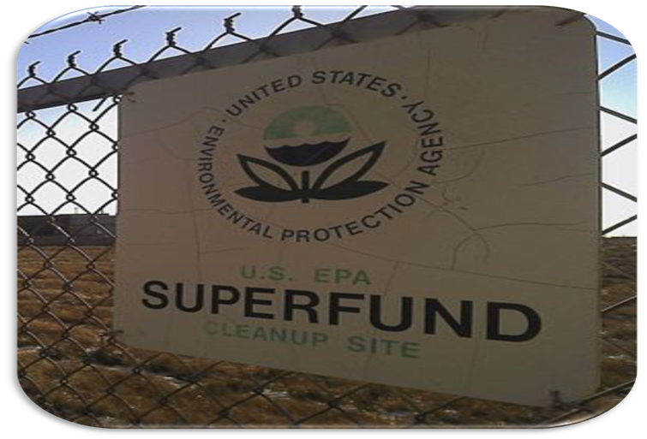
Federal EPA Pushes to Remove PFAS
Asserting PFAS create risks to public health, environment
Enforceable drinking water limits to replace unenforceable health advisories
Declaring PFOA, PFOS probable carcinogens
Goal is zero, feasible limit is 4 parts per trillion
Proposed Superfund liability for environmental discharges
Moving to ban import, manufacture, use of PFAS in commercial products
Coming Soon: PFAS permit limits in solid waste, wastewater

Slide 27
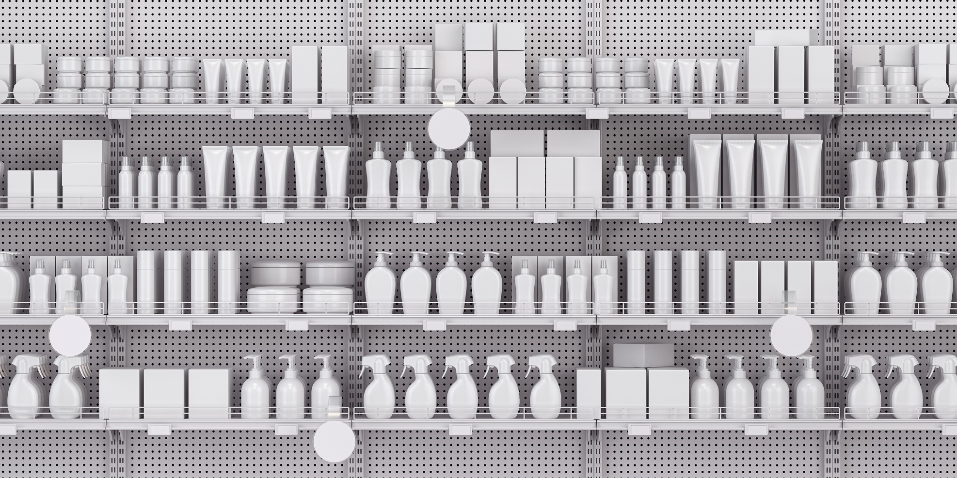
Short Term Impacts, Long Term Trends
Driving out PFAS will drive up costs
Few alternatives currently
Replacements must be researched
Removing existing PFAS will be costly
Initially, consumer goods may become scarce
Expect spike in class actions for consumer goods
Legal challenges will taper off as supply chains exclude PFAS
Long term challenge: cleaning up PFAS contamination

Slide 28
State Bans on PFAS in Products
State | Products Regulated | Compliance Date
California | Food packaging | January 1, 2023
 | Juvenile products | July 1, 2023
 | Cosmetics | January 1, 2025
 | Textile articles | January 1, 2025
Colorado | Juvenile products | January 1, 2024
 | Carpets and rugs | January 1, 2024
 | Oil and gas products | January 1, 2024
 | Fabric treatments | January 1, 2024
 | Food packaging | January 1, 2024
 | Indoor upholstered furniture | January 1, 2025
 | Cosmetics | January 1, 2025
 | Indoor textile furnishings | January 1, 2025
 | Outdoor upholstered furniture | January 1, 2027
 | Outdoor textile furnishings | January 1, 2027

Slide 29
State Bans on PFAS in Products
State | Products Regulated | Compliance Date
Connecticut | Food packaging | As soon as feasible but no later than December 31, 2023
Hawaii | Food packaging | July 1, 2023
Maine | Carpets, rugs and fabric treatments | January 1, 2023
 | All products | January 1, 2030
 | Pesticides | January 1, 2030
Maryland | Food packaging | January 1, 2024
 | Rugs and carpets | January 1, 2024
 | Cosmetics | January 1, 2025

Slide 30
State Bans on PFAS in Products
State | Products Regulated | Compliance Date
Minnesota | Food packaging | January 1, 2024
New York | Food packaging | December 31, 2022
 | Apparel | December 31, 2023
Rhode Island | Food packaging | January 1, 2024
Vermont | Rugs, carpets | July 1, 2023
 | Food packaging | July 1, 2023
 | Ski wax | July 1, 2023
 | Aftermarket stain and water-resistant treatments | July 1, 2023
Washington | Food packaging | February 2023 and May 2024

Slide 31
Trends in PFAS Litigation

Slide 32
PFAS Litigation Trends
Consumer Product Claims
Medical Monitoring Class Actions
Environmental Litigation
AFFF Litigation

Slide 33
Hardwick Class Action
Class Action in Southern District of Ohio
Filed in 2018 against PFAS manufacturers.
Plaintiff alleged detectable levels of PFAS in his blood, but no health condition.
Proposed a nationwide class, not limited to any product or exposure pathway.
Plaintiff seeks a science panel and medical monitoring for people with at least 0.05 PPT of PFOA and PFAS in blood serum.

Slide 34
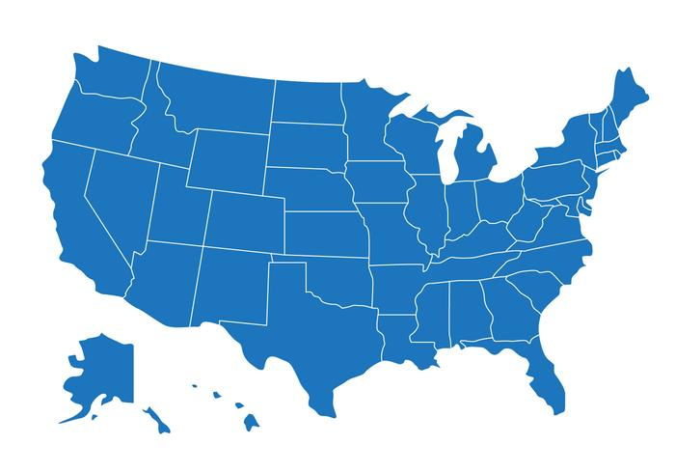
Hardwick Class Action
Class Certification
District Court certified class:
Individuals subject to the laws of Ohio” who have 0.05 ppt of PFOA and at least 0.05 ppt of any other PFAS in their blood serum.
But Court’s ruling suggested the class could be nationwide.
Sixth Circuit granted Defendants’ request for interlocutory review, expressing skepticism of the District Court’s ruling.

Slide 35
What is AFFF?
Aqueous Film-Forming Foam
Fire suppressant used to fight flammable liquid fires
Contains foaming agents and typically a PFAS-based fluorosurfactant
Commonly used at manufacturing facilities, airports, oil refineries, military bases, oil tankers, offshore platforms

Slide 36
AFFF MDL
Aqueous Film-Forming Foam Multidistrict Litigation – MDL No. 2873
Over 3,300 claims and growing
United States District Court for the District of South Carolina
Allegations that AFFF contributed to contamination of local groundwater
Broad collection of individual and public and private plaintiffs
Defendants are PFAS manufacturers, AFFF manufacturers, equipment manufacturers, site owners, Department of Defense

Slide 37
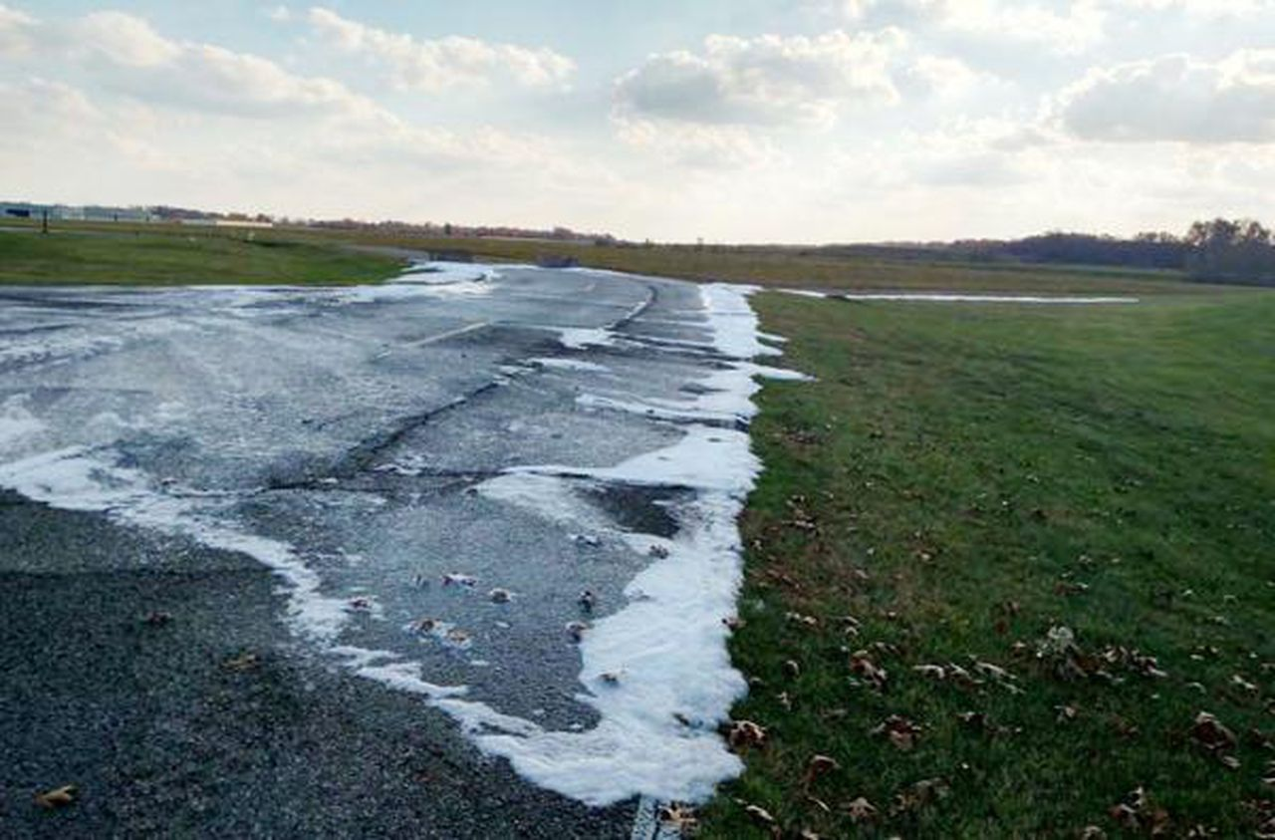
AFFF MDL
Public utility and water provider claims for contaminated water supplies
Medical monitoring class actions
Property owners for diminution of property value from PFAS contamination to a public or private water source
Attorney general actions seeking damages for harm to a state’s natural resources
Traditional personal injury claims seeking damages for a medical condition or other injury allegedly resulting from exposure to PFAS
AFFF MDL Claims

Slide 38
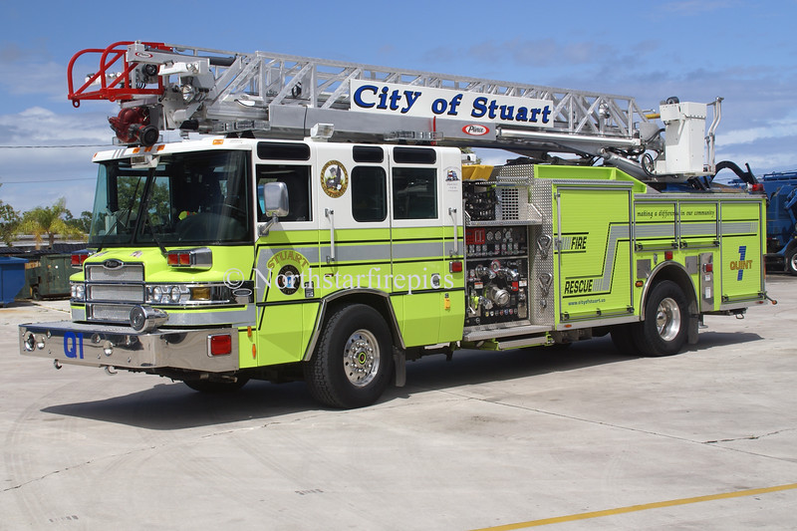
AFFF MDL
City of Stuart v. 3M Company, et al.
First bellwether trials are water provider cases.
City of Stuart, Florida brings claims against PFAS and AFFF manufacturers for contamination of municipal drinking water.
Contamination allegedly linked to Stuart Fire Rescue’s use of AFFF in training exercises.
Claims for failure to warn, design defect, negligence, and private nuisance.
Trial to start June 5.

Slide 39
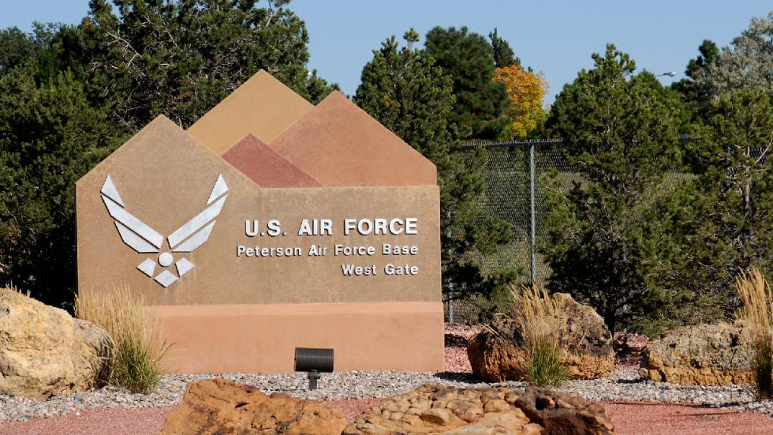
AFFF MDL
Leach Claims Bellwether Cases
Second pool of bellwether cases allege personal injury from contaminated drinking water.
Included Injuries:
Kidney cancer
Testicular cancer
Ulcerative colitis
Thyroid disease
Potentially pregnancy-induced hypertension

Slide 40
Questions?

