Slide 1
2023 CLASS ACTION MONEY & ETHICS CONFERENCE
MAY 8, 2023
7TH ANNUAL PRESENTED BY BEARD GROUP, INC.
CONFERENCE
SPONSORED BY

Slide 2
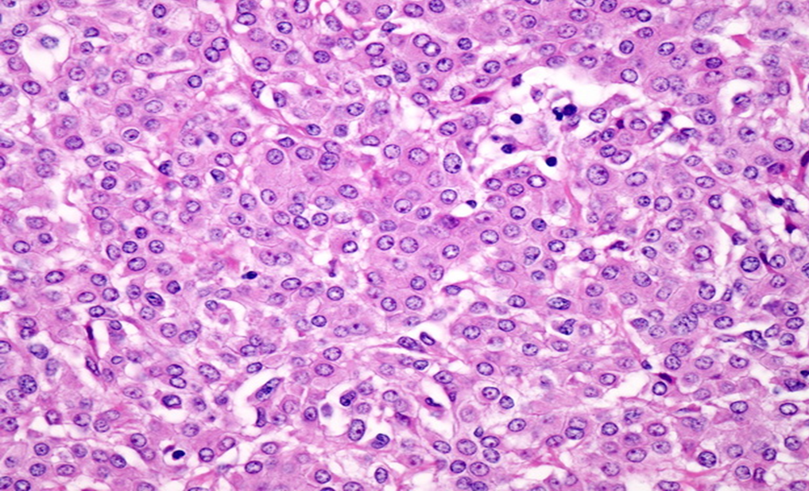
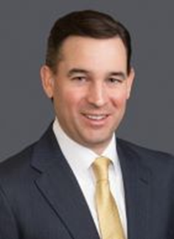
Mass Torts: Cases to Watch in 2023 Asbestos & Talc Litigation Updates and Verdicts May 8, 2023
Christopher C. Ege
Co-Managing Partner Austin, Texas cege@grsm.com

Slide 3
Total Asbestos and Talc Verdicts by Year
As of April 13, 2023

Slide 4
Plaintiffs’ v. Defense Verdicts by Year

Slide 5
Percentage of Verdicts by Disease (2020 - 2023)

Slide 6
Average Verdict Values (2020–2023)

Slide 7
Asbestos Claims – Filings
Total Filings are Down (7% decrease in 2022)
Lung Cancer Filings Down Significantly (-18%)
IL (Madison County) remains at the top (27%)
Increased filings in CA
Decreased filings in IL, MO and WV
Gori, Simmons, Weitz, Maune, SWMW top filers
Top Mesothelioma Filing States: IL, NY, PA, CA
* See 2022 Asbestos Litigation Report - Mesothelioma Claims & Trends - KCIC

Slide 8
Talc Exposures in Asbestos Claims
For 2022 –
29% Increase in Asbestos Filings with Talc Exposures
11% of all Asbestos Filings have Talc Claims
Madison County, IL remains top jurisdiction for Talc Claims
54% of all Los Angeles filings included Talc Claims
48% of all Talc Claims were Female
* See 2022 Asbestos Litigation Report - Mesothelioma Claims & Trends - KCIC

Slide 9
Nuclear Verdicts - California
William Gaborko v. Emerson Electric, et al.
Los Angeles, California
Weitz & Luxenberg
Deceased 84 year old Plaintiff
Mesothelioma
$40 million awarded (Emerson Electric – 65%, U.S. Navy – 10%, Contributory Negligence – 25%)

Slide 10
Nuclear Verdicts - Connecticut
Peckham v. R.T. Vanderbilt, Inc.
Connecticut
Waters Kraus & Paul
Deceased 76 year old Plaintiff
Mesothelioma
$20 million awarded against Vanderbilt and DAP

Slide 11
Nuclear Verdicts – South Carolina
Sarah Plant v. Avon Products, Inc., et al.
South Carolina
Dean Omar Branham Shirley, LLP
36-year old plaintiff
Mesothelioma
$29.14 million award (Whittaker Clark Daniels – 100%; IMI Fabi 0%)

Slide 12
Trends in Asbestos & Talc Litigation
Contaminated Talc Cases
Corporate Restructuring & Buy Outs
Spontaneous/Idiopathic Defense

Slide 13
Key Procedural & Statutory Updates
Bankruptcy Trust Transparency Laws
Over-naming Reform Disclosure Laws
New York Special Master – Punitive Damages Discovery

Slide 14
Key Opinions and New Case Law
US Supreme Court – Personal Jurisdiction (Mallory v. Norfolk)
Is registering to do business in a state enough?
California Case Law – Corporate Representatives
Berroteran v. Ford – Prior Depositions
Ramirez v. Avon Products, Inc. – Personal Knowledge

Slide 16
2023 CLASS ACTION MONEY & ETHICS CONFERENCE
MAY 8, 2023
7TH ANNUAL PRESENTED BY BEARD GROUP, INC.
CONFERENCE
SPONSORED BY

