Slide 1
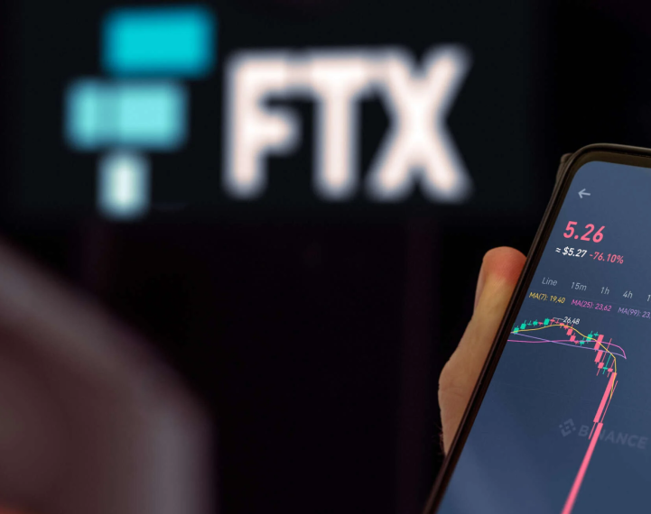
AFTER FTX: Crypto Lawyers and Class Actions
What’s next???

Slide 3
Crypto: What the Hell Is It???

Slide 4
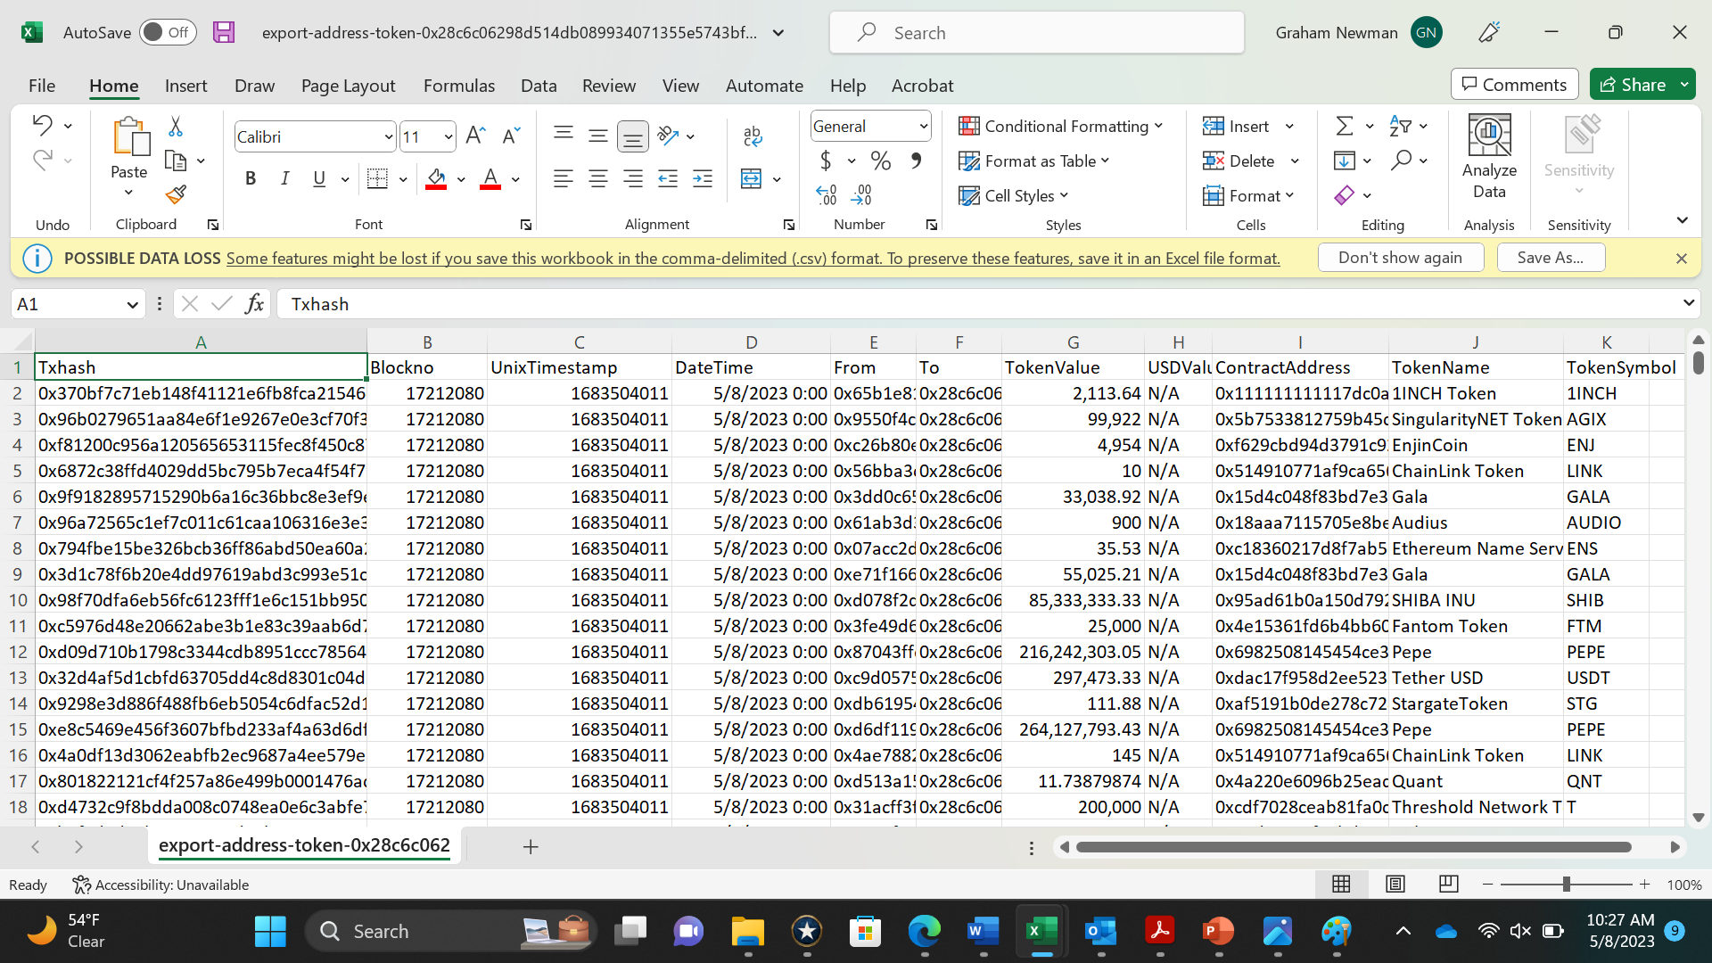
Basics of the Technology
Open-source computer program
Distributed ledger
Immutable data protected by cryptography
Means of exchange of “coins”

Slide 5
What Crypto Is NOT
ANONYMOUS
0x28C6c06298d514Db089934071355E5743bf21d60

Slide 6
Primary Crypto Use Cases
Banking for the Bankless
Investment Vehicles
Crime and Fraud

Slide 7
Crypto Oversight: Whose Backyard???

Slide 8
Major Types of Crypto Class Actions
Centralized Exchanges
Shitcoins
“Aiding and Abetting” cases

Slide 9
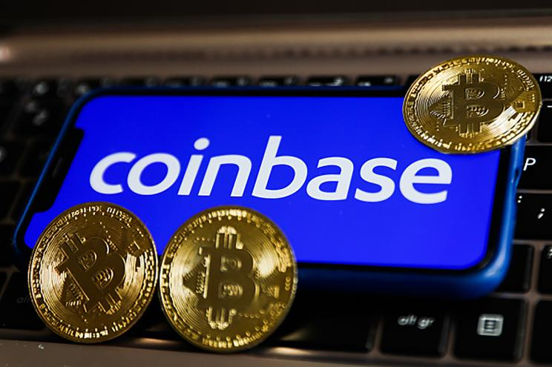
Centralized Exchanges

Slide 10
SHITCOINS!!!!

Slide 12
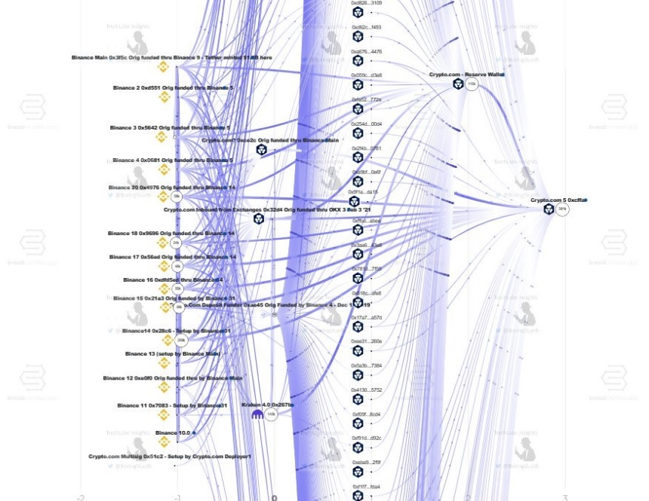
Blockchain Tracing

Slide 13
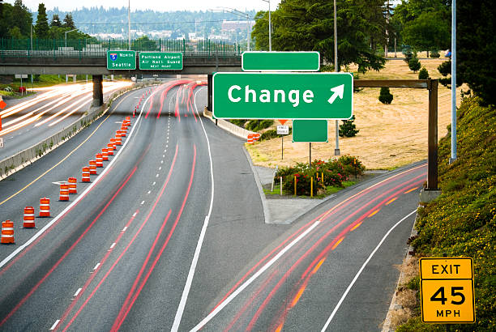
“Off-Ramps”
“AML”/”KYC” Requirements
Name
Date of Birth
Address
Government identification number

Slide 14
Reach Out to Us!
Michael Canty
Labaton Sucharow, LLP
mcanty@labaton.com
Graham Newman
Chappell, Chappell & Newman
graham@chappell.law

