Slide 1
Litigating ESG Consumer Class Actions
May 8, 2023
Baldassare Vinti
bvinti@proskauer.com
Jeff Warshafsky
jwarshafsky@proskauer.com
Jennifer Yang
jyang@proskauer.com

Slide 2

Green Guides Overview
Courts often look to the Green Guides as a basis for determining whether environmental claims are misleading
  In some states, including California, compliance with the Green Guides provides a safe harbor
Issued by the Federal Trade Commission
  Last updated in 2012
  Currently seeking public comment for revisions

Slide 3

General Environmental Benefit Claims

Slide 4

Green Guides § 260.4 – General Environmental Benefit Claims
§ 260.4 General environmental benefit claims.
(a) It is deceptive to misrepresent, directly or by implication, that a product, package, or service offers a general environmental benefit.
(b) Unqualified general environmental benefit claims are difficult to interpret and likely convey a wide range of meanings. In many cases, such claims likely convey that the product, package, or service has specific and far-reaching environmental benefits and may convey that the item or service has no negative environmental impact. Because it is highly unlikely that marketers can substantiate all reasonable interpretations of these claims, marketers should not make unqualified general environmental benefit claims.
(c) Marketers can qualify general environmental benefit claims to prevent deception about the nature of the environmental benefit being asserted. To avoid deception, marketers should use clear and prominent qualifying language that limits the claim to a specific benefit or benefits. Marketers should not imply that any specific benefit is significant if it is, in fact, negligible. If a qualified general claim conveys that a product is more environmentally beneficial overall because of the particular touted benefit(s), marketers should analyze trade-offs resulting from the benefit(s) to determine if they can substantiate this claim.
(d) Even if a marketer explains, and has substantiation for, the product’s specific environmental attributes, this explanation will not adequately qualify a general environmental benefit claim if the advertisement otherwise implies deceptive claims. Therefore, marketers should ensure that the advertisement’s context does not imply deceptive environmental claims.

Slide 5

Green Guides Example – “Eco-friendly”
The brand name ‘‘Eco-friendly’’ likely conveys that the product has far-reaching environmental benefits and may convey that the product has no negative environmental impact. Because it is highly unlikely that the marketer can substantiate these claims, the use of such a brand name is deceptive.
A claim, such as ‘‘Eco-friendly: made with recycled materials,’’ would not be deceptive if: (1) The statement ‘‘made with recycled materials’’ is clear and prominent; (2) the marketer can substantiate that the entire product or package, excluding minor, incidental components, is made from recycled material; (3) making the product with recycled materials makes the product more environmentally beneficial overall; and (4) the advertisement’s context does not imply other deceptive claims.

Slide 6

Green Guides Example – “Greener”
A marketer states that its packaging is now ‘‘Greener than our previous packaging.’’ The packaging weighs 15% less than previous packaging, but it is not recyclable nor has it been improved in any other material respect. The claim is deceptive because reasonable consumers likely would interpret ‘‘Greener’’ in this context to mean that other significant environmental aspects of the packaging also are improved over previous packaging.
A claim stating ‘‘Greener than our previous packaging’’ accompanied by clear and prominent language such as, ‘‘We’ve reduced the weight of our packaging by 15%,’’ would not be deceptive, provided that reducing the packaging’s weight makes the product more environmentally beneficial overall and the advertisement’s context does not imply other deceptive claims.

Slide 7
Green Guides Example – Implied Claims
A marketer’s advertisement features a picture of a laser printer in a bird’s nest balancing on a tree branch, surrounded by a dense forest. In green type, the marketer states, ‘‘Buy our printer. Make a change.’’ Although the advertisement does not expressly claim that the product has environmental benefits, the featured images, in combination with the text, likely convey that the product has far-reaching environmental benefits and may convey that the product has no negative environmental impact. Because it is highly unlikely that the marketer can substantiate these claims, this advertisement is deceptive.

Slide 8
Rawson et al v. ALDI, Inc., No. 1:21-cv-02811 (N.D. Ill. 2021)
“Simple. Sustainable. Seafood.”

Slide 9
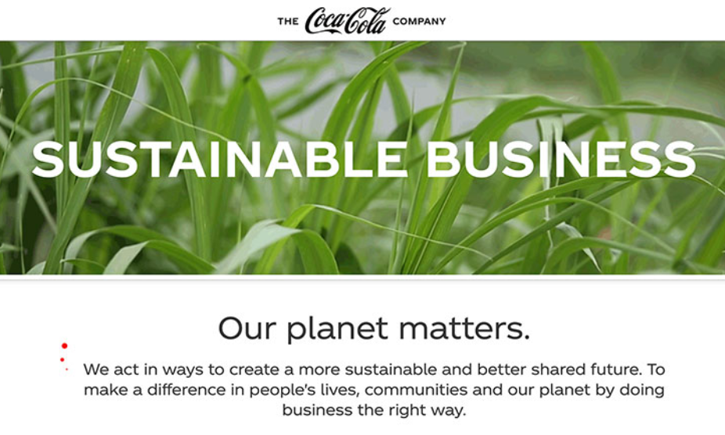
Earth Island Institute v. The Coca-Cola Co., No. 2021 CA 001846 B
(D.C. Super. Ct. 2021)

Slide 10
Earth Island Institute v. The Coca-Cola Co., No. 2021 CA 001846 B
(D.C. Super. Ct. 2021)
General Aspirational Statements:
“Our planet matters. We act in ways to create a more sustainable and better shared future. To make a difference in people’s lives, communities and our planet by doing business the right way.”
“Scaling sustainability solutions and partnering with others is a focus of ours.”
“We’re using our leadership to achieve positive change in the world and build a more sustainable future for our communities and our planet. . .I’m reminded of the power of our people to make a difference, to serve our communities and constantly work to shape a more sustainable business.”

Slide 11
Earth Island Institute v. The Coca-Cola Co., No. 2021 CA 001846 B
(D.C. Super. Ct. 2021)
“More specific, future statements”:
“Part of our sustainability plan is to help collect and recycle a bottle or can for every one we sell globally by 2030.”
“Make 100% of our packaging recyclable globally by 2025. [And] [u]se at least 50% recycled material in our packaging by 2030.”

Slide 12
Earth Island Institute v. The Coca-Cola Co., No. 2021 CA 001846 B
(D.C. Super. Ct. 2021)
Order Granting Motion to Dismiss
  Challenged statements were aspirational in nature
  Challenged statements were not tied to a “product or service”
  Challenged statements could not be “cobbled together” to allege one actionable misrepresentation

Slide 13
Carbon Offsets & Carbon Neutral Claims

Slide 14
Green Guides § 260.5 – Carbon Offsets
Marketers should have competent and reliable scientific evidence to support carbon offset claims, and use appropriate accounting methods to ensure they measure emission reductions correctly and don’t sell offsets more than once
Marketers must disclose whether the offset represents emission reductions that will not occur for two years or longer
Marketers should not advertise a carbon offset if they are required by law to conduct the offsetting activity

Slide 15
Dwyer v. Allbirds, Inc., No. 7:21-cv-05238 (S.D.N.Y. 2021)
Challenged Claims: Carbon footprint claims for Allbirds shoes
Plaintiff’s Allegations: Plaintiff relied on a PETA report that criticized Allbirds’ LCA methodology and data source
Decision:
  The Court granted Allbirds’ Motion to Dismiss
  Criticism of the LCA’s methodology is not an allegation that its figures are false
  Disclosures made clear it relied on Higg MSI as its data source

Slide 16
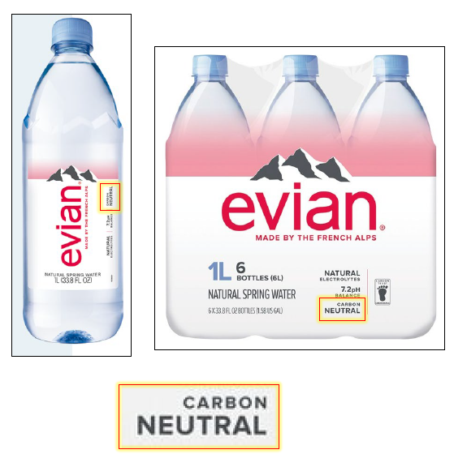
Dorris v. Danone Waters of America, No. 7:22-cv-08717 (S.D.N.Y. 2022)
Challenged Claim: “Carbon Neutral”
Plaintiff’s Allegations:
  “Reasonable consumers often mistake carbon neutral for ‘carbon zero’ or ‘carbon free’.”
  “‘carbon offset’ definition of ‘carbon neutral’ is still false” because “the organizations Defendant works with that are the basis for its ‘carbon credits’ do not currently or actually reduce CO2 emissions . . . .”

Slide 17

Dakus v. KLM, N.V., No. 1:22-cv-07962 (S.D.N.Y 2022)
Challenged Claims: Promoting the purchase of carbon credits through KLM’s CO2ZERO program to “fly responsibly” and “creat[e] a more sustainable future”
Plaintiff’s Allegations:
  No credible evidence that purchasing carbon offsets balances out the environmental effects of flying
  Carbon offsets do not account for other greenhouse gases associated with flying

Slide 18
Environmental Certifications

Slide 19

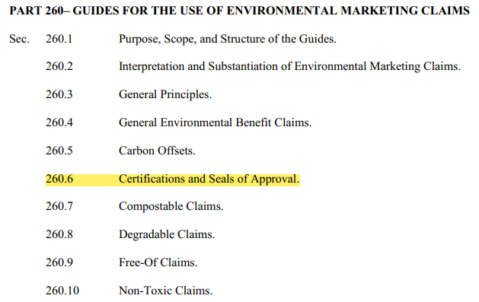
Green Guides § 260.6 – Certifications and Seals of Approval
It is deceptive to misrepresent, directly or by implication, that a product, package, or service has been endorsed or certified by an independent third party.

Slide 20
Green Guides § 260.6(c) & § 260.6(d) – Substantiation Required
Even if the third-party certification is genuine, marketer still has an obligation to ensure that it has substantiation for all claims reasonably communicated by the certification
Likely conveys that the product offers a general environmental benefit (if the certification or seal does not convey the basis for the certification or seal)
“Because it is highly unlikely that marketers can substantiate general environmental benefit claims, marketers should not use environmental certifications or seals that do not convey the basis for that certification, either through the name or some other means”

Slide 21
Green Guides Example – Environment Approved (Green Guides § 260.6)
A one-quart bottle of window cleaner features a seal with the text ‘‘Environment Approved,’’ granted by an independent, third-party certifier with appropriate expertise. The certifier granted the seal after evaluating 35 environmental attributes.
This seal likely conveys that the product has far-reaching environmental benefits and that Environment Approved certified the product for all of these benefits and therefore is likely deceptive.
The seal would likely not be deceptive if the marketer accompanied it with clear and prominent language clearly conveying that the seal refers only to specific and limited benefits.
  For example, the seal could state: ‘‘Virtually all products impact the environment. For details on which attributes we evaluated, go to [a Web site that discusses this product].’’ The referenced Web page provides a detailed summary of the examined environmental attributes.
  A reference to a Web site is appropriate because the additional information provided on the Web site is not necessary to prevent the advertisement from being misleading.
  The marketer also should ensure that the advertisement does not imply other deceptive claims, and that the certifier’s criteria are sufficiently rigorous to substantiate all material claims reasonably communicated by the certification.

Slide 22
Sanchez et al. v. Walmart Inc., No. 23-cv-1297 (N.D. Ill. 2023)
Plaintiff alleged that defendant falsely markets it products as “certified sustainable food” and supports such claim by placing a Marine Stewardship Council (MSC) blue stamp on product labels when MSC allows members to pay for the certification and gives the certification to products that are sourced using methods that harm marine life and ocean habitats.

Slide 23
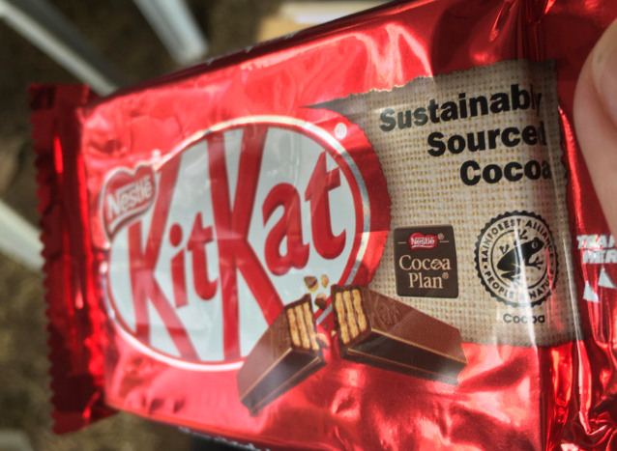
Walker v. Nestle USA, Inc., 2022 WL 901553 (S.D. Cal. 2022)

Slide 24
Recyclable Claims

Slide 25

Green Guides § 260.12 – Recyclable Claims

Slide 26
Green Guides § 260.12 – Recyclable Claims

Slide 27
Green Guides § 260.12 – Recyclable Claims

Slide 28
Swartz v. The Coca-Cola Company, No. 21-cv-04643 (N.D. Cal 2021)
Haggerty v. Bluetrition Brands, Inc., No. 21-cv-13904 (D.N.J. 2021)
Duchimaza v. Niagara Bottling, LLC, No. 21-cv-06434 (S.D.N.Y. 2021)
Challenged Claim: “100% Recyclable”
Plaintiff’s Allegations:
  Bottles made of PET
    Domestic facilities only have capacity to process 22.5% of total PET
  Labels made of BOPP
    BOPP is usually sent to landfills or burned.
  Caps made of PP or HDPE
    PP is usually sent to landfills or burned.
    Domestic facilities only have capacity to process 12% of total HDPE

Slide 29
Duchimaza v. Niagara Bottling, LLC, No. 21-cv-06434 (S.D.N.Y. 2021)
Motion to Dismiss Granted
  First, the Green Guides focus on the availability of recycling facilities, not the incidence of recycling. Thus, Plaintiff’s theory that MRFs are turning away plastic recycling did not state a claim
  Second, while some caps and the labels are made with PP plastics, which Plaintiff alleges are not recyclable, the court found these were “minor, incidental components” of the bottles under the Green Guides

Slide 30
Swartz v. The Coca-Cola Company, No. 21-cv-04643 (N.D. Cal 2021)
Motion to Dismiss Granted
    No reasonable consumer would understand “100% recyclable” to mean that the entire product will always be recycled
    Plaintiffs’ interpretation of “recyclable” was inconsistent with the Green Guides

Slide 31
Haggerty v. Bluetrition Brands, Inc., No. 21-cv-13904 (D.N.J. 2021)
Motion to Dismiss Granted
    Lack of Standing to Seek Monetary Damages
      Court held Plaintiff failed to plead economic injury under a premium price theory as complaint failed to put forth any facts regarding comparable or cheaper products to show Plaintiff paid a premium price
    Lack of Standing to Seek Injunctive Relief
      Court held that Plaintiffs’ theory that she is exposed to future risk due to her desire to purchase Defendant’s products in the future was too speculative and “lack the necessary imminency and do not result in a substantial risk of harm sufficient to generate an independent injury.”

Slide 32
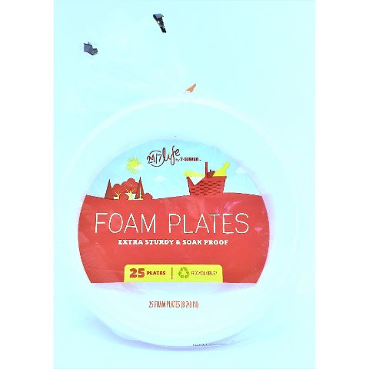
Curtis v. 7-Eleven, Inc., No. 1:21-cv-06079 (N.D. Ill. 2021)
Challenged Claim: “Recyclable”
Plaintiffs’ Allegations: Products (a) do not have Resin Identification Code and therefore cannot be separated in the recycling process and actually be recycled, and (b) are made of materials that most facilities do not recycle.
Defendant: “Recyclable” does not mean a product will be recycled. Instead, the word simply means “capable of being recycled.” And the dictionary definition is consistent with how the term is defined in the FTC Green Guides.

Slide 33
Curtis v. 7-Eleven, Inc., No. 1:21-cv-06079 (N.D. Ill. 2021)
The Court:
  Plaintiff failed to state a claim under the theory that recycling facilities are few and far between.
  Motion to dismiss denied as to theory that the bottles lack RIC markings on the products themselves and, without the markings, the products cannot be recycled.

Slide 34
Recycling Bags
Cases:
Hanscom v. Reynolds Consumer Prods. Inc., No. 21-cv-03434 (N.D. Cal. 2021)
Halim v. Reynolds Consumer Prods., Inc., No. 21-cv-04194 (N.D. Ill. 2021)
Canaday v. Reynolds Consumer Products, Inc., No. 22-cv-03513 (N.D. Ill. 2022)
Millam v. Walmart Inc., No. 22-cv-01090 (C.D. Cal. 2022)
Challenged Claims:
Recycling bags are made of certain type of plastic that is not recyclable and actually contaminates the waste stream
Marketed as recyclable in order to take advantage of consumers demand for recyclable products
Case Status: MTD denied in Hanscom (subsequently voluntarily dismissed); Halim voluntarily dismissed; no responsive pleading filed in Canaday; and notice of voluntary dismissal filed in Millam

Slide 35
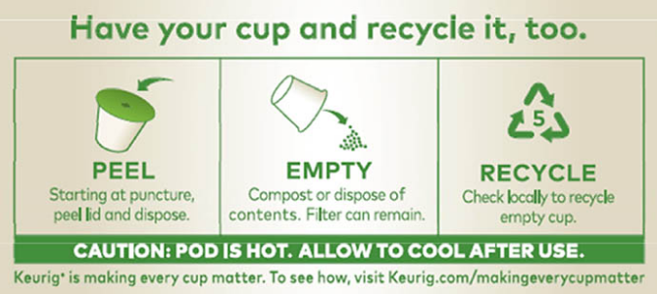
Smith v. Keurig Green Mountain, No. 4:18-cv-06690-HSG (N.D. Cal. 2018)
Plaintiff:
  Keurig K-cups not recyclable because they are too small to be recycled in many communities, and often arrived contaminated with food or with paper filter in place and most recycling facilities are not capable of cleaning the pods to allow them to be recycled
Motion to Dismiss Denied
Motion for Class Certification Granted
Settlement:
  “Keurig has agreed to modify all its labels, advertising, and marketing of the Challenged Products to prominently qualify any recycling representation with the statement ‘Check Locally – Not Recycled in Many Communities.’”
  $10 million fund

Slide 36
Biodegradable and Compostable Claims

Slide 37
Green Guides § 260.7 – Compostable Claims
Unqualified claims (direct and implied) should meet the following:
  Competent and reliable evidence
  Showing all materials of the product are compostable.
  Within a similar time period to that of underlying materials.
  In a safe and timely manner.
    Safe: The material must safely compost by use of composting facility or home compost pile or device. In a case where product is only compostable by a municipal or institutional facility, these facilities must be available to the substantial majority of consumers or communities where that product is sold.
    Time: The material should compost in a similar amount of time to that of the underlying material.
Where a claim does not satisfy criteria listed above, claim should be clearly qualified with a disclaimer on product labeling and other product advertisements.

Slide 38
Green Guides § 260.8 – Biodegradable Claims
Unqualified claims (direct and implied) should meet the following:
  Competent and reliable evidence
  Showing all materials of the product will completely break down to elements found in nature.
  Must take <1 year to fully decompose after entering solid waste stream.
  Must degrade under conditions in which product is customarily disposed.
  Requirement applies to any product packaged as: biodegradable, degradable, oxo-degradable, oxo-biodegradable or photodegradable.
Where a claim does not satisfy criteria listed above, claim should be clearly qualified with a disclaimer on product labeling and other product advertisements.

Slide 39
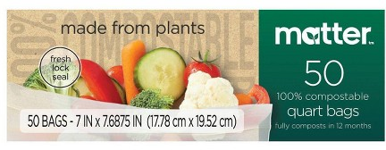
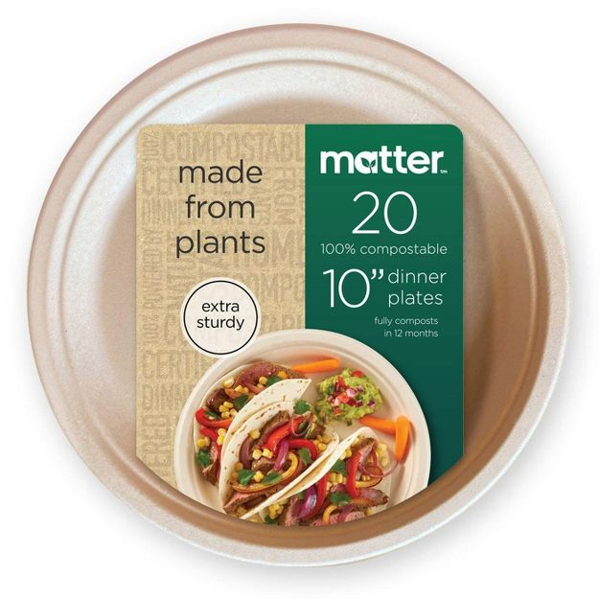
Little v. Naturestar North America, LLC, No. 1:22-cv-00232 (E.D. Cal. 2022)
Challenged Claims:
  Single-use plastic products marketed as compostable
Plaintiff’s Allegations:
  Plaintiffs allege that Defendants claims that all materials are compostable are false because they contain products contained polyfluoroalkyl substances (PFAS).
Defendants:
  California law (which goes into effect in 2026) limits “compostable” claims to products with no more than 100 ppm PFAS.
  Plaintiff’s claims contradict California law because they seek to impose a zero PFAS standard.
Case Status: MTD is pending

Slide 40

Natale v. 9199-4467 Quebec Inc., No. 1:21-cv-06775 (E.D.N.Y. 2021)
Challenged Claims:
  Earth Rated Certified Compostable Poop Bags for Pet Waste
Plaintiff’s Allegations:
  Bags are not compostable because pet waste is unsafe for home compost and industrial composting facilities are unavailable.
  Defendants’ disclaimers are inconspicuous and inconsistent with other messaging in the products’ packaging and advertisements.
Defendants:
  Defendants argue that their advertisements are consistent with certifications issued for home and industrial composting under standard specifications
  Have included necessary disclaimers on their website cautioning consumers against home composting for edible crops and advising consumers to check whether their local composting facilities accept pet waste.
  Given their full compliance with federal regulations and FTC Green Guides, no reasonable consumer could be deceived by their behavior.
Case Status: MTD is pending

Slide 41
Additional Litigation – Compostable & Biodegradable Claims
Bergus v. Beyondgreen Biotech, Inc., No. 1:21-cv-01954 (C.D. Cal. 2021):
  Brought under similar theory as Natale v. 9199-4467 Quebec, Inc. Plaintiffs allege that dog waste bags are falsely advertised as “compostable”. Case was voluntarily dismissed with prejudice on February 24, 2022, prior to filing of motion to dismiss
Yarmark v. RTG Custom Supply, LLC, No. 1:22-cv-02398 (E.D.N.Y. 2022)
  Brought under similar theory as Little v. Naturestar. Plaintiff alleged that defendants’ advertisement of single-use cutlery as biodegradable was deceptive due to presence of polyethelene in product upon degradation. Case was voluntarily dismissed with prejudice on August 12, 2022, prior to filing of motion to dismiss
Vences v. WaterWipes (USA), Inc., No. 1:23-cv-00619 (N.D. Ill. 2023)
  Plaintiff alleged that defendant’s claims that its wipes were “100% Biodegradable” were false because the products do not completely decompose within a reasonable time period after customary disposal as users customarily dispose of the products in the trash which means the wipes end up in places that do not have conditions necessary to allow for decomposition. Case was voluntarily dismissed with prejudice on April 27, 2023, prior to filing of motion to dismiss.

Slide 42
Non-Toxic Claims

Slide 43
Green Guides § 260.10 – Non-Toxic Claims
§ 260.10 Non-toxic claims.
It is deceptive to misrepresent, directly or by implication, that a product, package, or service is non-toxic. Non-toxic claims should be clearly and prominently qualified to the extent necessary to avoid deception.
A non-toxic claim likely conveys that a product, package, or service is non-toxic both for humans and for the environment generally. Therefore, marketers making non-toxic claims should have competent and reliable scientific evidence that the product, package, or service is non-toxic for humans and for the environment or should clearly and prominently qualify their claims to avoid deception.

Slide 44
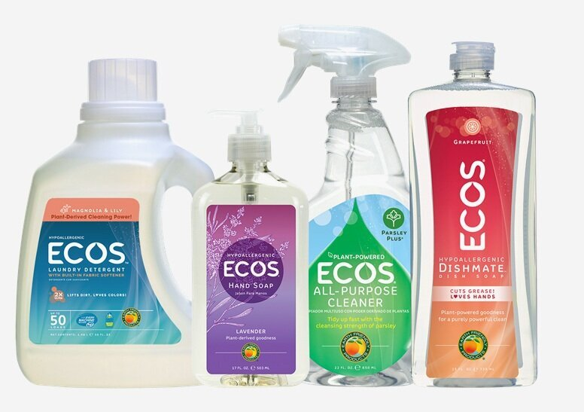
De Santiago v. Venus Labs, Inc., No. 4:22-cv-00841 (E.D. Mo. 2022)
Challenged Products: ECOS-brand consumer household products
Plaintiff’s Allegations: Products falsely marketed as “non-toxic,” “safer,” “climate positive,” and/or “sustainable”
Case Status: MTD Pending

Slide 45
Reef Safe/Reef Friendly Claims

Slide 46

Locklin v. StriVectin Operating Co., 3:21-cv-07967 (N.D. Cal 2021)
Plaintiff alleged “reef safe” label is misleading because several ingredients endanger the reefs
  Avobenzone
  Homosalate
  Octisalate
  Octocrylene
Plaintiff based these allegations on scientific studies on harmful effects of these chemicals and cited government bans on these chemicals
Strivectin moved to dismiss, arguing its label discloses that “reef safe” means the product does not contain oxybenzone or octinoxate, two other chemicals banned in Hawaii
The court denied the MTD

Slide 47
Locklin v. StriVectin Operating Co., 3:21-cv-07967 (N.D. Cal 2021)
“True enough, ‘information available to a consumer is not limited to the physical label and may involve contextual inferences regarding the product itself and its packaging.’ Moore v. Trader Joe's Co., 4 F.4th 874, 882 (9th Cir. 2021). And asterisks might cabin sweeping claims or further define ambiguous language. But a company can't say something misleading on the front of a label and escape liability by stating ‘that's not actually what we mean’ in fine print on the back. … StriVectin does not have free rein to define ‘reef safe’ to mean anything it wants.”

Slide 48
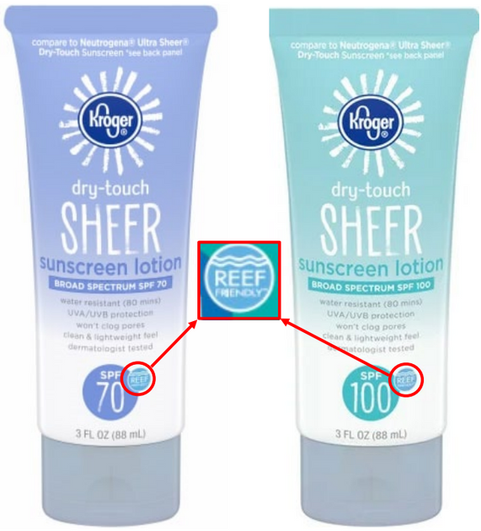
White v. Kroger Co., et al., No. 3:21-cv-08004 (N.D. Cal. 2021)
Kroger argued “reef friendly” is puffery, relying on cases finding other “friendly” terms (e.g., “user-friendly”) to be puffery
  The court found that “reef friendly” is not puffery, relying on the FTC’s Green Guides, which require substantiation for “friendly” claims such as “eco-friendly” and “environmentally friendly”
Kroger also argued the case should be dismissed or stayed under the primary jurisdiction doctrine because there is pending legislation in Congress that would direct the FDA to develop regulations for a “reef safe” designation on nonprescription sunscreen (Reef Safe Act of 2021, H.R. 4800, 117th Cong. (2021)
  The Court found this possibility too remote at this juncture

Slide 49
Battle v. Taylor James, LLC d/b/a Supergoop!, No. 2:21-cv-07915 (C.D. Cal. 2021)
“Reef-Safe”

Slide 50
Battle v. Taylor James, LLC d/b/a Supergoop!, 2022 WL 2162930 (C.D. Cal. June 15, 2022)
Plaintiff:
  Avobenzone and octocrylene are “toxic to human health, coral reefs and marine species.”
  Plaintiff cited an article from the Center for Biological Diversity to support this allegation.
  Plaintiff also alleged Hawaii’s Senate has passed legislation banning these chemicals and octocrylene is banned in sunscreen products sold in the U.S. Virgin Islands, Key West and the Marshall Islands.
Defendant:
  Plaintiff failed to satisfy Rule 9(b) in connection with supporting the allegation that the “reef-safe” claim is false.

Slide 51
Battle v. Taylor James, LLC d/b/a Supergoop!, 2022 WL 2162930 (C.D. Cal. June 15, 2022)
The Court:
  Plaintiff alleged the “who, what, when, where, and how” of the purported conduct.
  Reference to pending legislation in Hawaii seeking to ban the ingredients based on findings they are harmful to marine environments, existing bans in other locations, and the Center for Biological Diversity article stating the same together supported plaintiff’s allegation of falsity.
  Disagreed that plaintiff was bringing a lack-of-substantiation claim because, unlike in such cases, the plaintiff pointed to scientific evidence supporting plaintiff’s allegations.

Slide 52
Questions?

Slide 53
Get in Touch to Learn More About Class Actions

Slide 54
Learn More About Class Actions
Follow our blog: www.proskaueronadvertising.com
Reach out with questions or to sign up for updates on class action trends and developments: bvinti@proskauer.com, jwarshafsky@proskauer.com and jyang@proskauer.com

